Slide 1

Development of metabolomics data standards
Leibniz-Institut für Pflanzenbiochemie
Daniel Schober, IPB Halle
for COSMOS WP 2

Slide 2
Outline
Challenges in data storage, retrieval & mining
Introduction to symbolic data representation
XML
Controlled Vocabularies / Ontologies
Requirements & Introduction to nmrML data standard
Inhouse data example
Conclusions

Slide 3
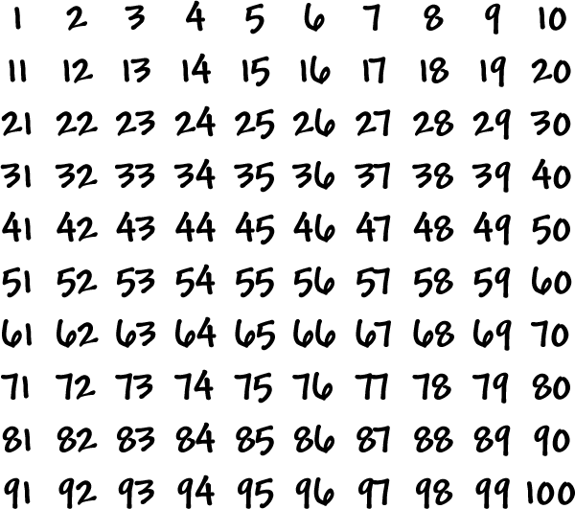

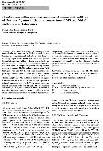
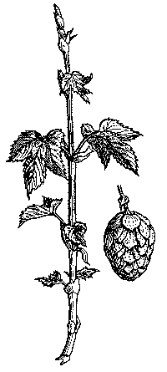

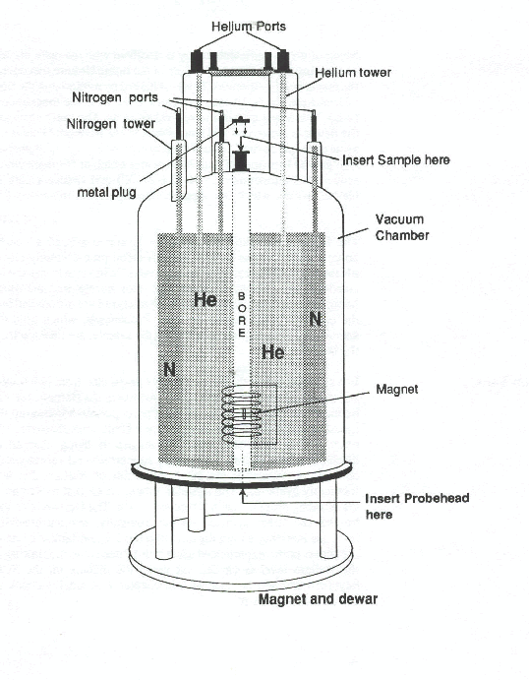
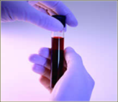
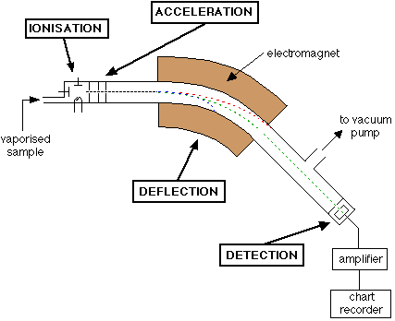


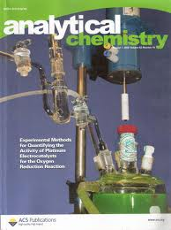
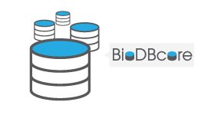


Need for reporting standards
Metabolomics workflow
Wet laboratory
Bioinformatics
Publication
Data storage, analysis
& interpretation
Sample collection
Assay: NMR, MassSpec, …
Findings
Data
Local inhouse management &
long term storage
Standard Needed !
Diverse technologies, parameters & data formats
Vendor formats are incompatible, verbose & hard to interpret
Data silos with restricted access
→ Need for open standard for robust data storage, sharing, retrieval & interpretation

Slide 4
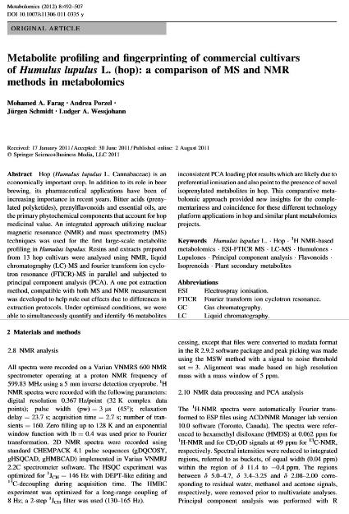
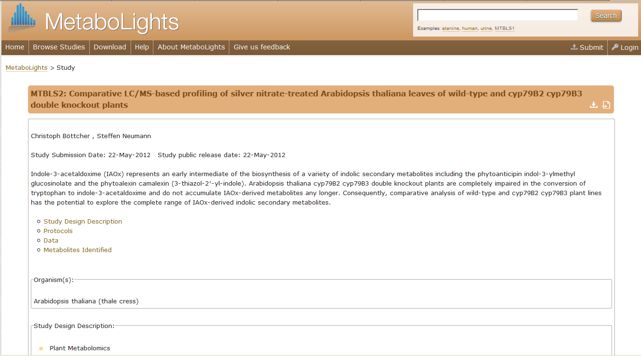
Metabolomics experiments described in papers & public repositories
What is wrong with this ?

Slide 5

Papers: human readable, but …

Slide 6
How to render data human & computer-readable Describe & annotate data with XML-based metadata
Challenge 1
?
!

Slide 7
Freetext: What information a computer can see …
WWW2002 The eleventh
Sheraton waikiki hotel
7-11 may 2002
1 location 5
Registered participants
australia, canada,
france, germany, ghana, hong kong,
india, ireland, italy, japan, malta,
No content-awareness
How to render data Human AND Computer readable ?

Slide 8
XML markup with “meaningful” tags
Data annotated with metadata
<name>WWW2002The eleventhl</name>
<location> Sheraton Waikiki aii, USA</location>
<date> 7-11 may 22</date>
<title> 1 location 5</title>
<topic>france, r now</topic>
<speaker>Tim berners-lee</speaker>
Presentation announcement

Slide 9
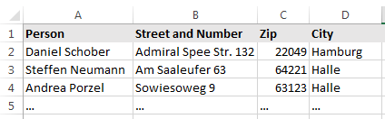
Semantic data annotation
Database analogy
Database: Columns define row content
<em>Daniel Schober</em>
<br>Admiral Spee Str. 7<br>
<strong>10439 Berlin</strong>
This row only intelligible when viewed in table context/header row
XML markup: Tags describe tag-content
This row also intelligible when viewed outside of the context, in any document
<person>Daniel Schober</person>
<address> <street>Admiral Spee Str. 11</street>
<zip> 22049</zip> <city>Hamburg</city> </address>
XML tag defines meaning, if tag is defined in ontology
Individual
Class
mammal
human
person
place
landmark
street
Readable to computers & humans alike
Context independent, decentralised annotation
→ Use XML and ontologies for metabolomics-standard specification

Slide 10
How to allow searches over variant textual expressions Converge by mapping variants to standardized term from controlled vocabulary
Challenge 2
?
!

Slide 11


Variances in expression decrease search results
Synonyms
Equivalence in Meaning
Different expressions for same thing
e.g. „Bleeding“, „Hemorrhage“, „Blutung“
Homonyms
Equivalence in Naming
Same expression for different things
e.g. „Jaguar“ for … and
Search this, miss that … ?
Search this, get that … ?

Slide 12
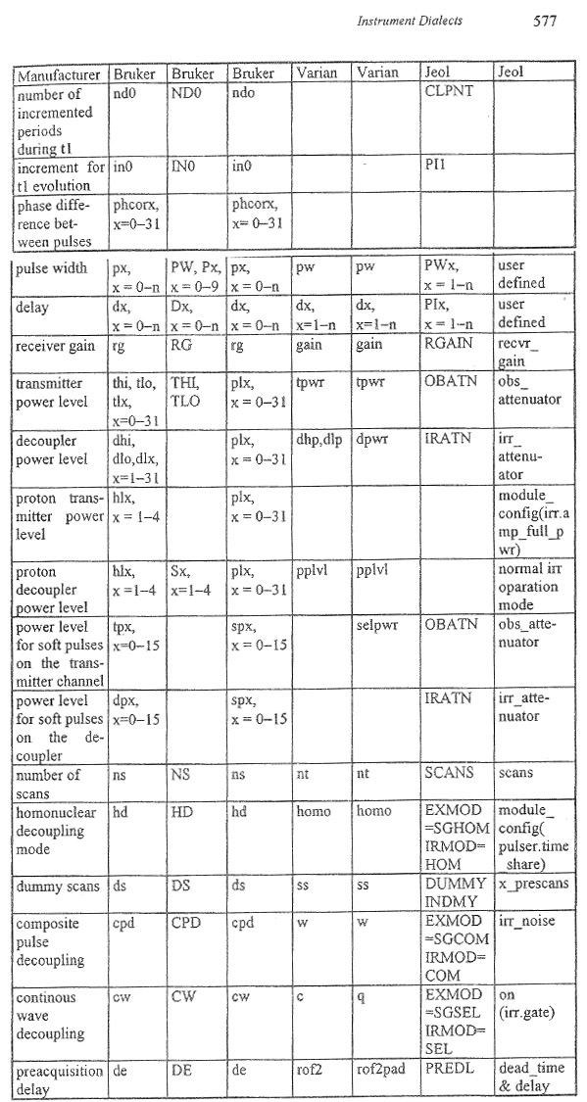
NMR formats
Variety in
parameters & vendor formats
Many synonyms:
relaxation delay, dx, PIx

Slide 13
Search internet for medical studies on
‚Prevention of esophageal varice bleeding‘
Efficacy of prophylactic sclerotherapy for prevention of a first varizeal hemorrhage.
Über die wirksame Vermeidung von Blutungen von Ösophagus Varizen.
Beta-blocker plus nitrate for primary prophylaxis of variceal bleeding.
Beta-blockers for avoiding haemorrhage in patients with esophageal varices.
Textual variance in study descriptors makes information retrieval difficult
Low recall, when searching for one variant only !

Slide 14

Synonym mapping via controlled terms (3 search aspects)
Bleeding
Hemorrhage(s)
Haemorrhage(s)
Ösophagusvarizen
Esophageal Varices
Prophylaxis
Prevention
Gene Ontology, GO: 18276
Gene Ontology, GO: 67326
Foundational Model of Anatomy ontology, FMA: 726
Retrieve more comprehensive results per aspect via canonized ontology term.
Synonyms converge onto standardized term → Search recall is increased !

Slide 15
Synonyms for ‚Irradiation Frequency‘ in NMR
„Nmr frequency“
„electromagnetic excitation“
„nuclei irradiation“
<xs:element name="irradiationFrequency" type="ValueWithUnitType"> </xs:element>

Slide 16
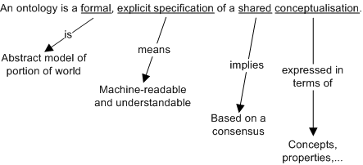
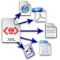
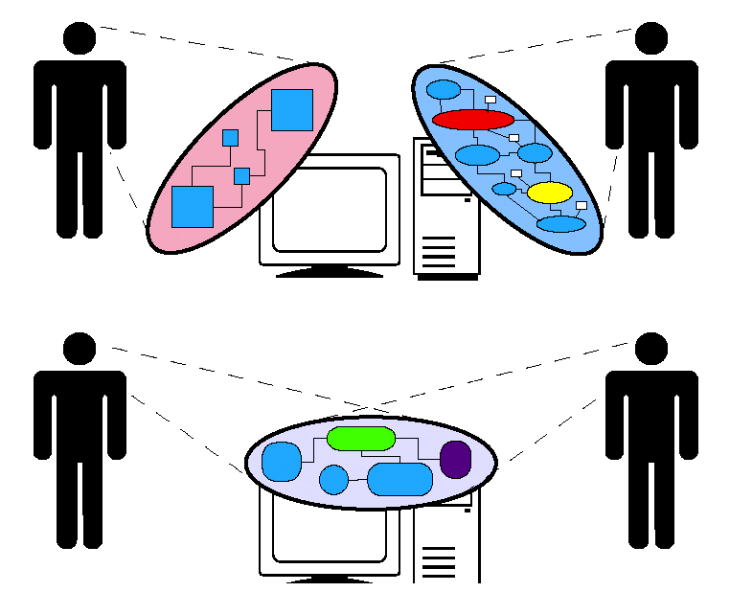
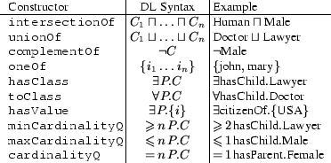

An ontology definition …

Slide 17

… another ontology definition
An ontology is a controlled vocabulary
in which descriptors for real world entities are set into relation to each other
Generalisation
Specialisation
ontology
knowledgebase
Animal
Mammal
Panthera onca
Carnivores
Panthera onca
Device
Vehicle
Car
Jaguar XJS Coupé
Boat
Individual
Relation Class Relation Class
This particular Jaguar
instanceOf Panthera onca is_a Mammal
instanceOf Jaguar XJS Coupé is_a Car

Slide 18

nmrML requirements http://cosmos-fp7.eu
Vendor-neutral open exchange & storage format
Understood by open tools & public repositories
Standard to facilitate data mining & reuse
Using ontology for synonym-convergence & homonym- resolution
Human & computer readable
Like mzML for Mass Spectrometry

Slide 19


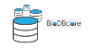








nmrML usage & implementation
coordinates
Open NMR Format
EU 7th FP
nmrML.xsd
Data Repositories
Persistent storage
nmrML combines XML elements
with controlled terms
in one XML file
Global
nmrCV.owl
MetaboLights
Local
Data Processing
Format Conversion
Semantic Validators
Parsers for vendor formats
JCampDX
Open NMR Tools
MetaboQuant

Slide 20
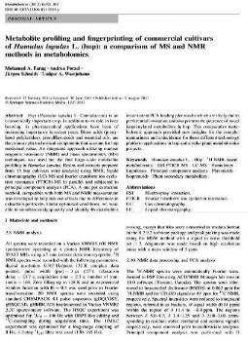
Example: annotation of ‚material & methods‘
NMR analysis
All spectra were recorded on a Varian VNMRS 600 NMR
spectrometer operating at a proton NMR frequency of
599.83 MHz using a 5 mm inverse detection cryoprobe. 1H NMR spectra
were recorded […].
XML-based annotation with nmrML
NMR analysis
All spectra were recorded on a
<Varian NMR Instrument> Varian VNMRS 600 NMR Spectrometer </Varian NMR Instrument>
operating at a proton NMR frequency of
<Irradiation frequency>599.83 <Megahertz>MHz</Megahertz> </Irradiation frequency>
using a <cryoprobe>5 mm inverse detection cryoprobe</cryoprobe>.
<acquisition nucleus>1H</acquisition nucleus> NMR spectra were recorded […].
object
instrument
NMR instrument
Varian NMR instrument
Varian VNMRS 600 NMR spectrometer
part of NMR Instrument
NMR probe
cryoprobe
5 mm inverse detection cryoprobe
parameter
acquisition parameter
acquisition nucleus
1H
Irradiatation frequency
unit
frequency unit
Megahertz
nmrCV
reference

Slide 21
Challenge 3
How to guide users in data acquisition
How to prevent erroneous annotations
How to validate data completeness
How to enforce journal policies & quality standards
?
!
Add a semantical definition layer

Slide 22
XML Schema validates XML data structure
XML Schema (simplified)
<xs:complexType name=“acquisitionParameterSet"> <xs:element name="acquisitionNucleus" type="CVTermType"/>
<xs:element maxOccurs="1“ name="irradiationFrequency" type="ValueWithUnitType">
</xs:element> […] </xs:complexType>
XML data file (example)
<acquisitionParameterSet> <acquisitionNucleus
name="1H“
cvRef=“nmrCV“ accession="NMR:1400151" />
<irradiationFrequency value="599.8311617" unitName=“Hertz" unitCvRef="UO" unitAccession="UO:0000106"/> </acquisitionParameterSet>
→ XSD ensures cardinalities & proper nesting

Slide 23
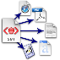








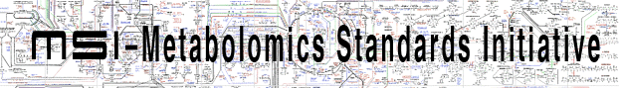

Onion model of validation layers
XML Syntax
Structural validity of nmrML XML instances
Semantic validity of CV term usage
Minimum Information Standard compliance
e.g. CIMR Core Information for Metabolomics Reporting
Journal Policy compliance

Slide 24
Current status & outlook
First release of nmrML standard at http://nmrml.org
Specification document, XSD, CV & example XML files
ready for alpha release
Good coverage on nmr raw data, less on multidimensional & processed NMR data
CV to be expanded in decentralised & data-driven manner
Investigations into RDF & semantic web realm

Slide 25
Conclusions
nmrML facilitates access to structured metabolomics data
Openess & standardization
Increase secondary data usage
Allow intelligent data mining
Advantages of using CV terms
Data quality increased by content validation
Computer-assisted interpretation of NMR data
More detailed search & more comprehensive retrieval of data
Homonym resolution, synonym coverage, generalisation, …

Slide 26
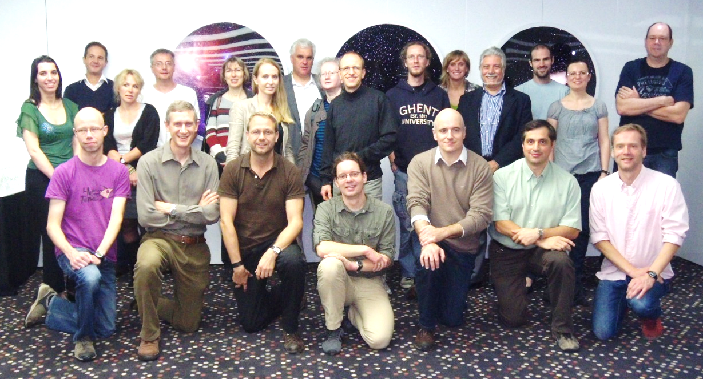

Acknowledgements
WP 2 nmrML group
Reza Salek, Mike Wilson, Steffen Neumann, Christian Ludwig, Ulrich Günter, Catherine Deborde, Daniel Joseph, Antonio Rosato, John Easton, Tim Ebbels, Kenneth Haug, Annick Moing, Luis de Figueiredo, Matthias Klein, Jan Hummel, Jan Hannemann, Philippe Rocca Serra & Denis Rubtsov, Jie Hao
Mike Wilson for coding the XSD
EU FP7 project COSMOS grant EC312941 www.cosmos-fp7.eu

